Slide 1
SNAKE AI – NEURAL NETWORK
By George Lopez

Slide 2

CONTENTS
01
LIVE TRAINING
02
MACHINE LEARNING THEORY
03
CODE SETUP
04
NEURAL NETWORK

Slide 3
01
LIVE TRAINING
Training the neural network to play snake

Slide 4
02
MACHINE LEARNING THEORY
Reinforcement Learning and Deep Q Learning

Slide 5
MACHINE LEARNING THEORY
REINFORCEMENT LEARNING
DEEP Q LEARNING
Machine Learning method to train a program (Snake Game)
Predict future actions
Maximise the reward of
Extension of reinforcement learning
Trains a neural network
Predicts actions to maximise reward

Slide 6
03
CODE SETUP
Explanation of the structure of the code

Slide 7
CODE SETUP
GAME CREATION
THE BRAIN
Creation of the Snake game
How the brain works

Slide 8

GAME CREATION
SNAKE
RULES:
PARAMETERS:
Collect food
REWARD
Tracks the quality of each move
Do NOT collide with the walls
GAME OVER
Tracks whether the game is over or not
Do NOT collide with the snake
SCORE
Tracks the score of the current game

Slide 9

THE BRAIN
THE BRAIN
SNAKE GAME
THE NEURAL NETWORK

Slide 10
THE ROLE OF THE BRAIN
GET THE CURRENT GAME STATE
PREDICTING THE NEXT ACTION
PASSING ACTION THROUGH A PLAY ITERATION
COLLECT NEW STATE
Direction of the snake
Danger elements around the snake
Distance from the food
Grab the current state
Use current state in neural network to predict next action
TRAIN THE NEURAL NETWORK
01
02
Take all the parameters from each state (old and new)
Pass through the neural network
Collect the new state as a result of the predicted action
Store the old state and new state in memory
Pass the predicted action through a game iteration step
Analyse the outputted REWARD, GAME OVER and SCORE
03
04
05

Slide 11
04
NEURAL NETWORK
Parameters, Structure, Training

Slide 12
PARAMETERS
Reward Parameter
Analyse reward after each game iteration
Reward provides a quality measurement of the action
Eat Food = +10
Collision = -10
Example:
Otherwise = 0
+10

Slide 13

PARAMETERS
Action Parameter
This defines the next direction of the snake
Only use 3 directions to stop a 180 degrees turn
STRAIGHT =[1,0,0]
RIGHT =[0,1,0]
Example:
LEFT =[0,0,1]
[0,0,1]
LEFT

Slide 14
PARAMETERS
This parameter depicts the environment surrounding the snake
State Parameter
State = [
danger straight,
danger left
danger right,
left direction,
right direction,
up direction,
down direction,
food left, food right,
food up, food down
]
Example:
[0,0,0,
1,0,0,0,
1,0,1,0]

Slide 15
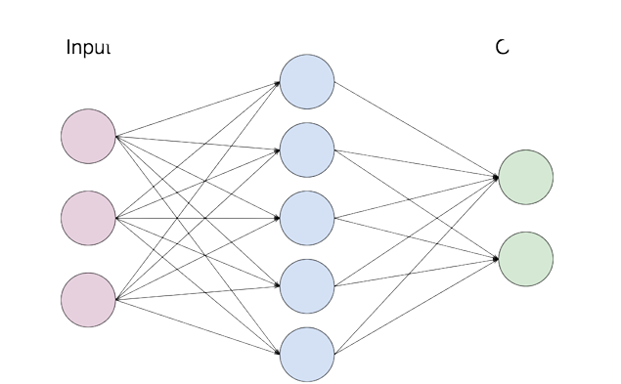
STRUCTURE
STRUCTURE OF THE NEURAL NETWORK
Action
[1,0,0]
INPUT LAYER = 11 NODES
Game
State
[0,0,0,
1,0,0,0,
1,0,1,0]
HIDDEN LAYER = 256 NODES
…
…
OUTPUT LAYER = 3 NODES
Input Layer
…
Output
Layer
Hidden
Layer

Slide 16
TRAINING
TRAINING THE NEURAL NETWORK
START HERE!
INITIALISATION
Give our model an initial Q value
MEASURE
Measure the reward parameter of this action
ADJUST
Adjust the Q value in our model using the Bellman’s equation
ACTION
Give the snake an action
(e.g. move left)
Initially random then predicted by the model
PERFORM
Perform the action given to the snake

Slide 17

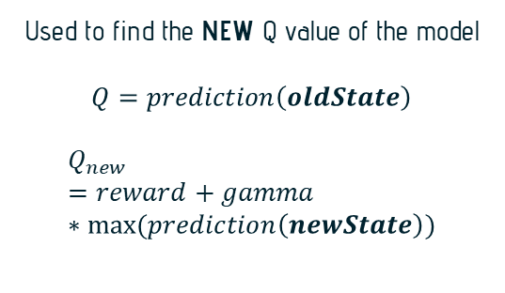
TRAINING
TRAINING CRITERION
BELLMAN EQUATION
LOSS FUNCTION:
MEAN-SQAURED ERROR
Used to find the NEW Q value of the model
$$Q=prediction\left(oldState\right)$$
$$Q_{new}=reward+gamma ∗max⁡(prediction\left(newState\right))$$
The aim is to minimise the mean-squared error in our model
$$meanSquaredError={\left(Q_{new}−Q\right)}^{2}$$

Slide 18
05
RESULTS
Results of the neural network

Slide 19
06
NEXT STEPS
Future improvements to the neural network

Slide 20
NEXT SETPS
ADD EXTRA LAYERS
ADJUST PARAMETERS
CHANGE TRAINING CRITERION
GAME STATE MODIFICATION
Adding extra layers to the neural network
In our model we can adjust parameters to see their effect
Changing Mean-Squared Error to Cross Entropy
Add variables to the game state to detect if snake will box itself in

Slide 21
GAME OVER
THANK YOU FOR LISTENING!
Any questions?

